Slide 1
MLDS 2018 Spring
HW4-2 - Deep Q Learning
2018/6/8
ntu.mldsta@gmail.com

Slide 2
Notification
If you want to present in class, please start your hw4 ASAP

Slide 3
Time Schedule
June 1st 4-1 announce
Policy Gradient
June 8th 4-2 announce
Deep Q learning
June 15th 4-3 announce
Actor-Critic
July 6th 23:59 Deadline (all in one)

Slide 4
Outline
Outline
Introduction
Game Playing : Breakout
Deep Reinforcement Learning
Deep Q-Learning (DQN)
Improvements to DQN
Grading & Format
Grading Policy
Code Format
Report
Submission

Slide 5
Environment
Introduction
Breakout

Slide 6
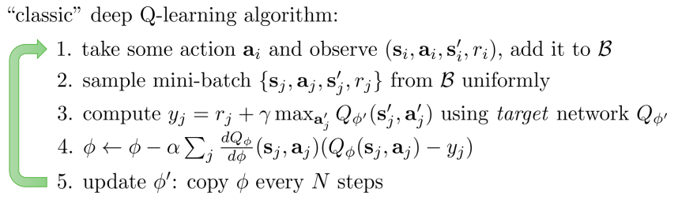
Deep Q-Learning (DQN)
Deep Reinforcement Learning
Replay buffer

Slide 7
Deep Q-Learning (DQN)
Deep Reinforcement Learning
The action should act ε-greedily
Random action with probability ε
Also in testing
Linearly decline ε from 1.0 to some small value, say 0.025
Decline per step
Randomness is for exploration, agent is weak at start
Hyperparameters
Replay Memory Size 10000
Perform Update Current Network Step 4
Perform Update Target Network Step 1000
Learning Rate 1.5e-4
Batch Size 32

Slide 8
Improvements to DQN
Deep Reinforcement Learning
Double Q-Learning
Dueling Network
Prioritized Replay Memory
Noisy DQN
Distributional DQN
https://arxiv.org/pdf/1710.02298.pdf

Slide 9
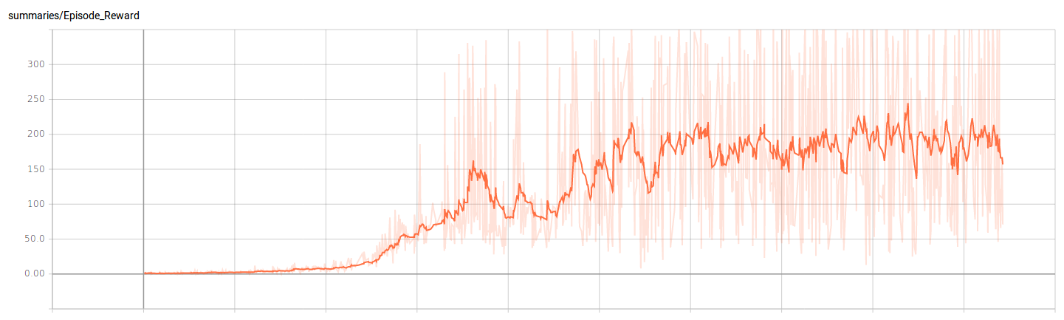
Training Plot
Training Tips
X-axis : 1000 episodes/unit
Y-axis : Unclipped reward per episode
Baseline is achieved within an hour of training

Slide 10
Why Reward is clipped
Training Tips
Performing the same action for 4 frames
To use data more efficiently
Reward may be up to 4
If positive, clip to 1 → reduce variance
How to see your unclipped reward
Use the test function
Turn off the clip_reward option of your environment and do the clipping by yourself.

Slide 11
Asynchronous Update (Optional, for Tensorflow)
Training Tips
In tensorflow, feed_dict does the copy thing
Upon updating, the agent have to wait for it to continue exploring.
Try run the update asynchronously
Main thread : Collect data
The other thread : Copy data to GPU
GPU : Training
Using the thread/multiprocessing module
This is totally not necessary for you to get baseline, just some speed-up you can try.
This can go wrong and annoying if you’re not familiar with threading, thus I recommend not to try it unless you are confident enough.

Slide 12
Grading Policy
Grading & Format
Code Baseline (5%)
Report (5%)

Slide 13
Baseline (5%)
Grading & Format
DQN (5%)
Getting averaging reward in 100 episodes over 40 in Breakout
With OpenAI’s Atari wrapper & reward clipping
We will unclip the reward when testing

Slide 14
Code Format
Grading & Format
Please download the sample files from github
Follow the instructions in README to install required packages
Four functions you should implement in agent_[pg|dqn].py
__init__(self, env, args)
init_game_setting(self)
train(self)
make_action(self, state, test)
DO NOT add any parameter in __init__(), init_game_setting() and make_action()
You can add new methods in the agent_[pg|dqn].py
You can add your arguments in argument.py

Slide 15
Report (10%)
Grading & Format
Up to 6 pages (4-1 + 4-2 + 4-3), in Chinese
Describe your DQN model (1%)
Plot the learning curve to show the performance of your Deep Q Learning on Breakout (1%)
X-axis: number of time steps
Y-axis: average reward in last 30 episodes
Implement 1 improvement method on page 6
Describe your tips for improvement (1%)
Learning curve (1%)
Compare to origin Deep Q Learning(1%)

Slide 16
Late submission
Grading & Format
Please fill the late submission form first only if you will submit HW late
Please push your code before you fill the form
There will be 25% penalty per day for late submission, so you get 0% after four days
You get 0% if the required files has bug.
If the error is due to the format issue, please come to fix the bug at the announced time, or you will get 10% penalty afterwards.

Slide 17
Submission
Grading & Format
Deadline: 2018/7/6 23:59 (GMT+8)
Your github MUST have 5 files under directory hw4/
agent_dir/agent_pg.py
agent_dir/agent_dqn.py
[saved_model_file] * 2
report.pdf
argument.py (optional)
README (optional)
download.sh (optional)
other files you need
If your model is too large for github, upload it to a cloud space and write download.sh to download the model
Do not upload any file named the same with other sample codes

Slide 18
Grading
Grading & Format
Please use Python with version >= 3.5
The TAs will execute ‘python3 test.py --test_pg --test_dqn’ to run your code on ubuntu
The execution for both model should be done within 10 minutes respectively, excluding model download
Allowed packages
PyTorch v0.3.0
Tensorflow r1.6 (CUDA 9.0)
Numpy
Scipy
Pandas
Python Standard Lib
No keras !!!! No keras !!!! No keras !!!! No keras !!!! No keras !!!!
If you use other packages, please ask for permission first

Slide 19
Related Materials
Course & Tutorial:
Berkeley Deep Reinforcement Learning, Fall 2017
David Silver RL course
Nips 2016 RL tutorial
Blog:
Andrej Karpathy’s blog
Arthur Juliani’s Blog
Text Book:
Reinforcement Learning: An Introduction
Repo:
https://github.com/williamFalcon/DeepRLHacks

Slide 20

Double DQN
Deep Reinforcement Learning
The formula often overestimates the maximum Q value.
Thus instead choose the action of the max Q in the target network, choose the action of the max Q in the current network.
https://arxiv.org/pdf/1710.02298.pdf
Which is a_j’ = max_a_j’Q_ϕ(s_j’, a_j’), then y _j= r_j + gamma * Q_ϕ’(s_j’, a_j’)

Slide 21
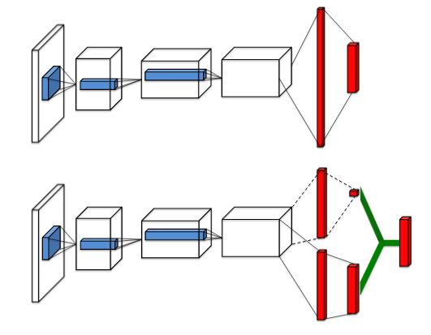
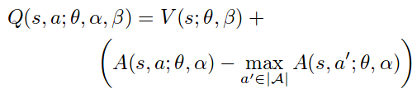
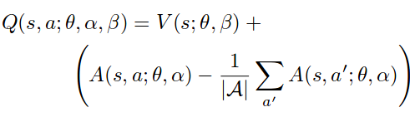
Dueling Network
Deep Reinforcement Learning
In many state, action does not counts.
DQN trys to find out the max Q in each state
Use same network to output Value and Advantage
Why should it be the Advantage?
Add loss constraint
Alternative Q function, more stable (more used)

Slide 22

Prioritized Replay Memory
Deep Reinforcement Learning
DQN : Sample from replay memory uniformly
We can sample the replays with large loss more often
Thus we sample with the probability
TD ERROR =
p_t ∝ |TD ERROR|^ω
ω is a hyperprameter, 0.5 in Rainbow
https://arxiv.org/pdf/1511.05952.pdf

Slide 23


Prioritized Replay Memory
Deep Reinforcement Learning
However, the resulting gradient estimator is biased, since we are sampling from a different distribution
Correct by inportance sampling weights
With ρ_i = 1 / P(i), the IS weights
β is linearly declined to 1
β = 1 → Unbiased
Try to learn quicker → Try to converge correctly
https://arxiv.org/pdf/1511.05952.pdf

Slide 24
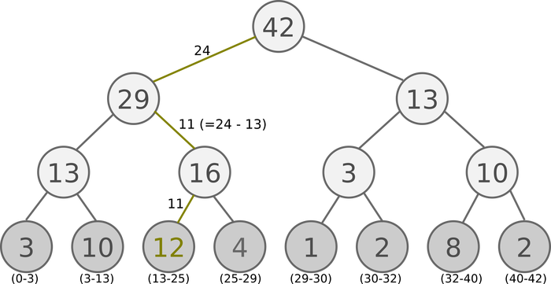
Prioritized Replay Memory
Deep Reinforcement Learning
Using array, the complexity of sampling is O(n)
Try another data structure
Sum Tree, which prioiritized sampling can be O(lgn)
Devide the priorities into k groups(batch size) by the max priority
That is if the max is 42, batch size = 6, we devide them into [1, 7], [8, 14], …., [36, 42]
Randomly sample a number from each interval
Go down the sum tree by the priority to retrieve the data at the leaf
https://arxiv.org/pdf/1511.05952.pdf

Slide 25
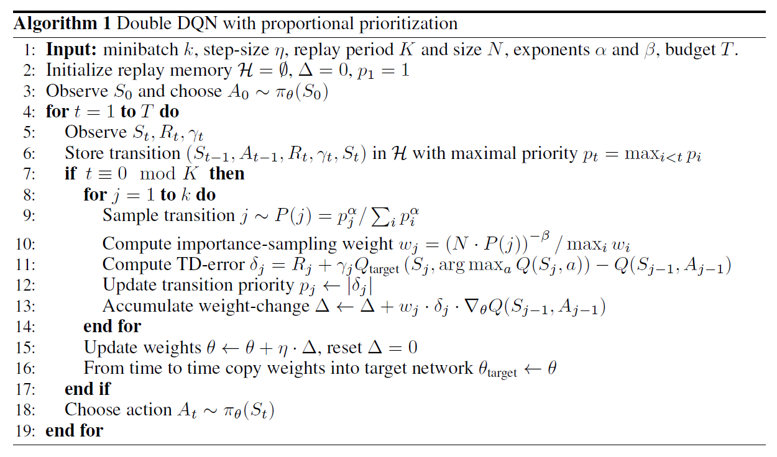
Prioritized Replay Memory
Deep Reinforcement Learning

